Slide 1
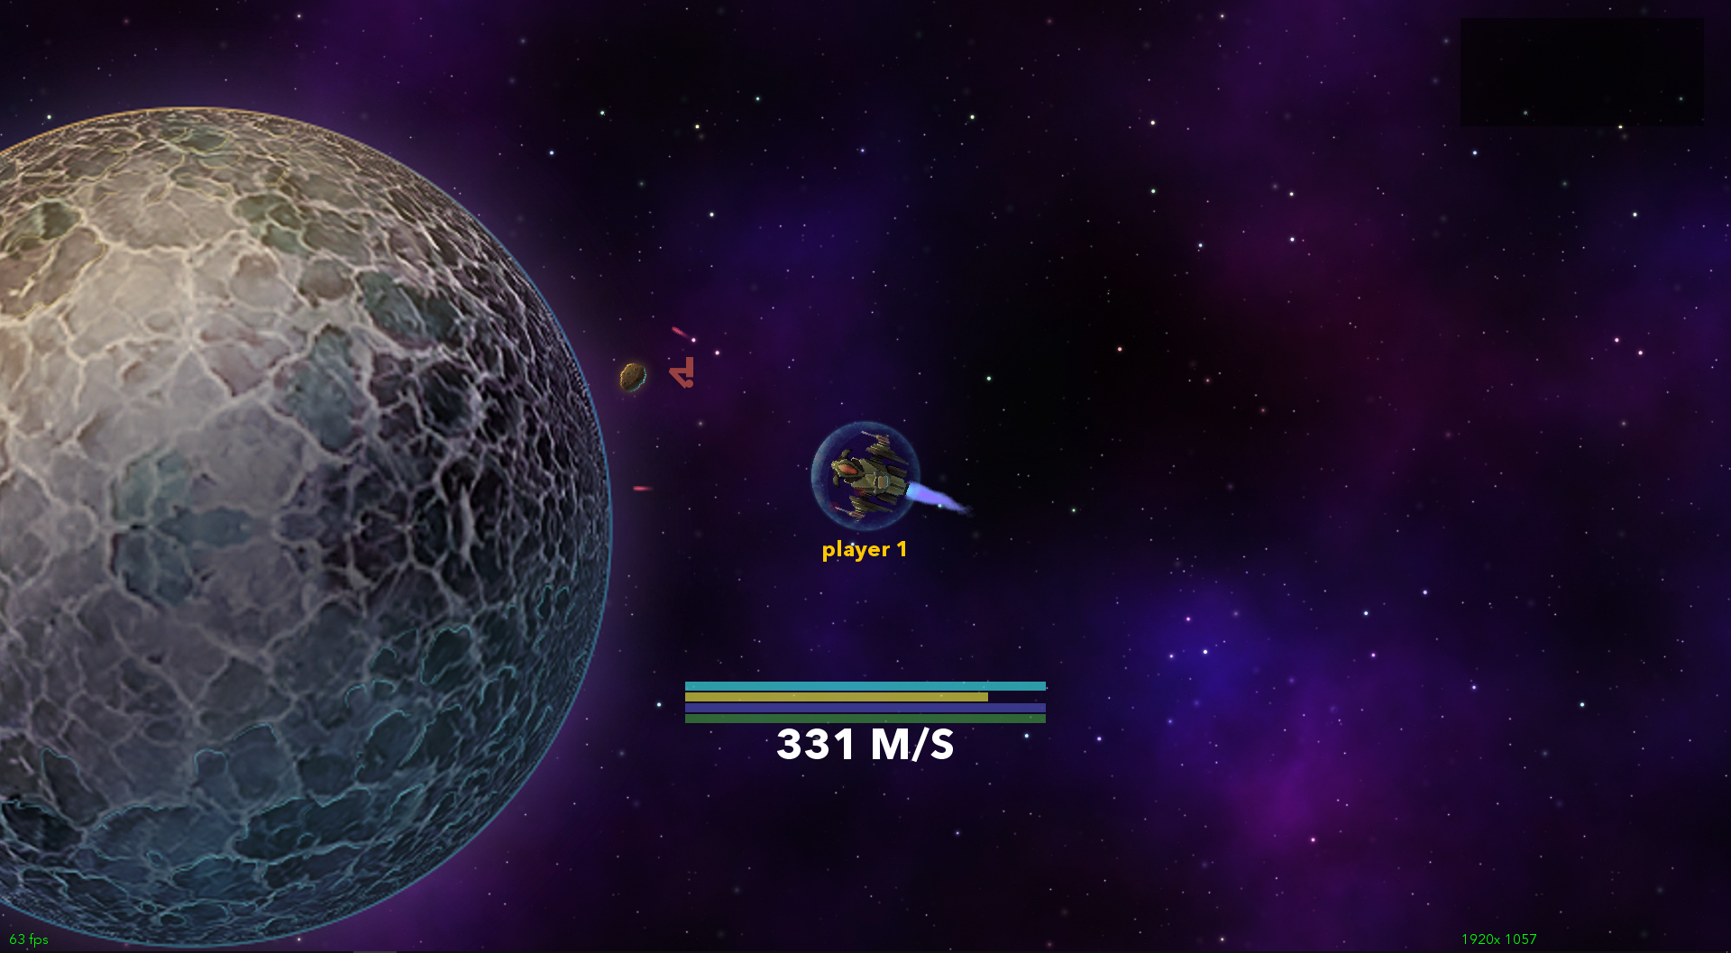
Big Space Game
Trevor Hedstrom

Slide 2
Program Operation
-Follow the menu to play the game
-Up to 32 player multiplayer
-Right click to thrust
-Left click to shoot
-Middle click to special shoot (big ships only)

Slide 3
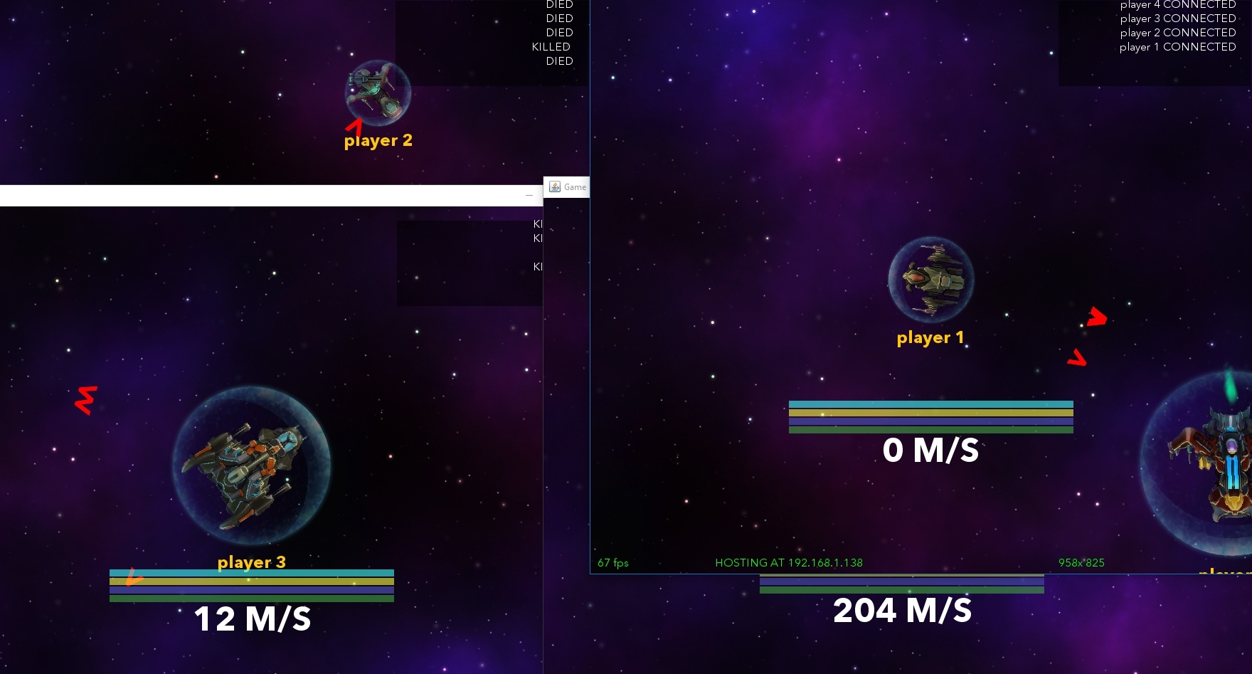
Demonstration
Multiplayer:

Slide 4
Demonstration
Planets and orbits (single-player only):

Slide 5
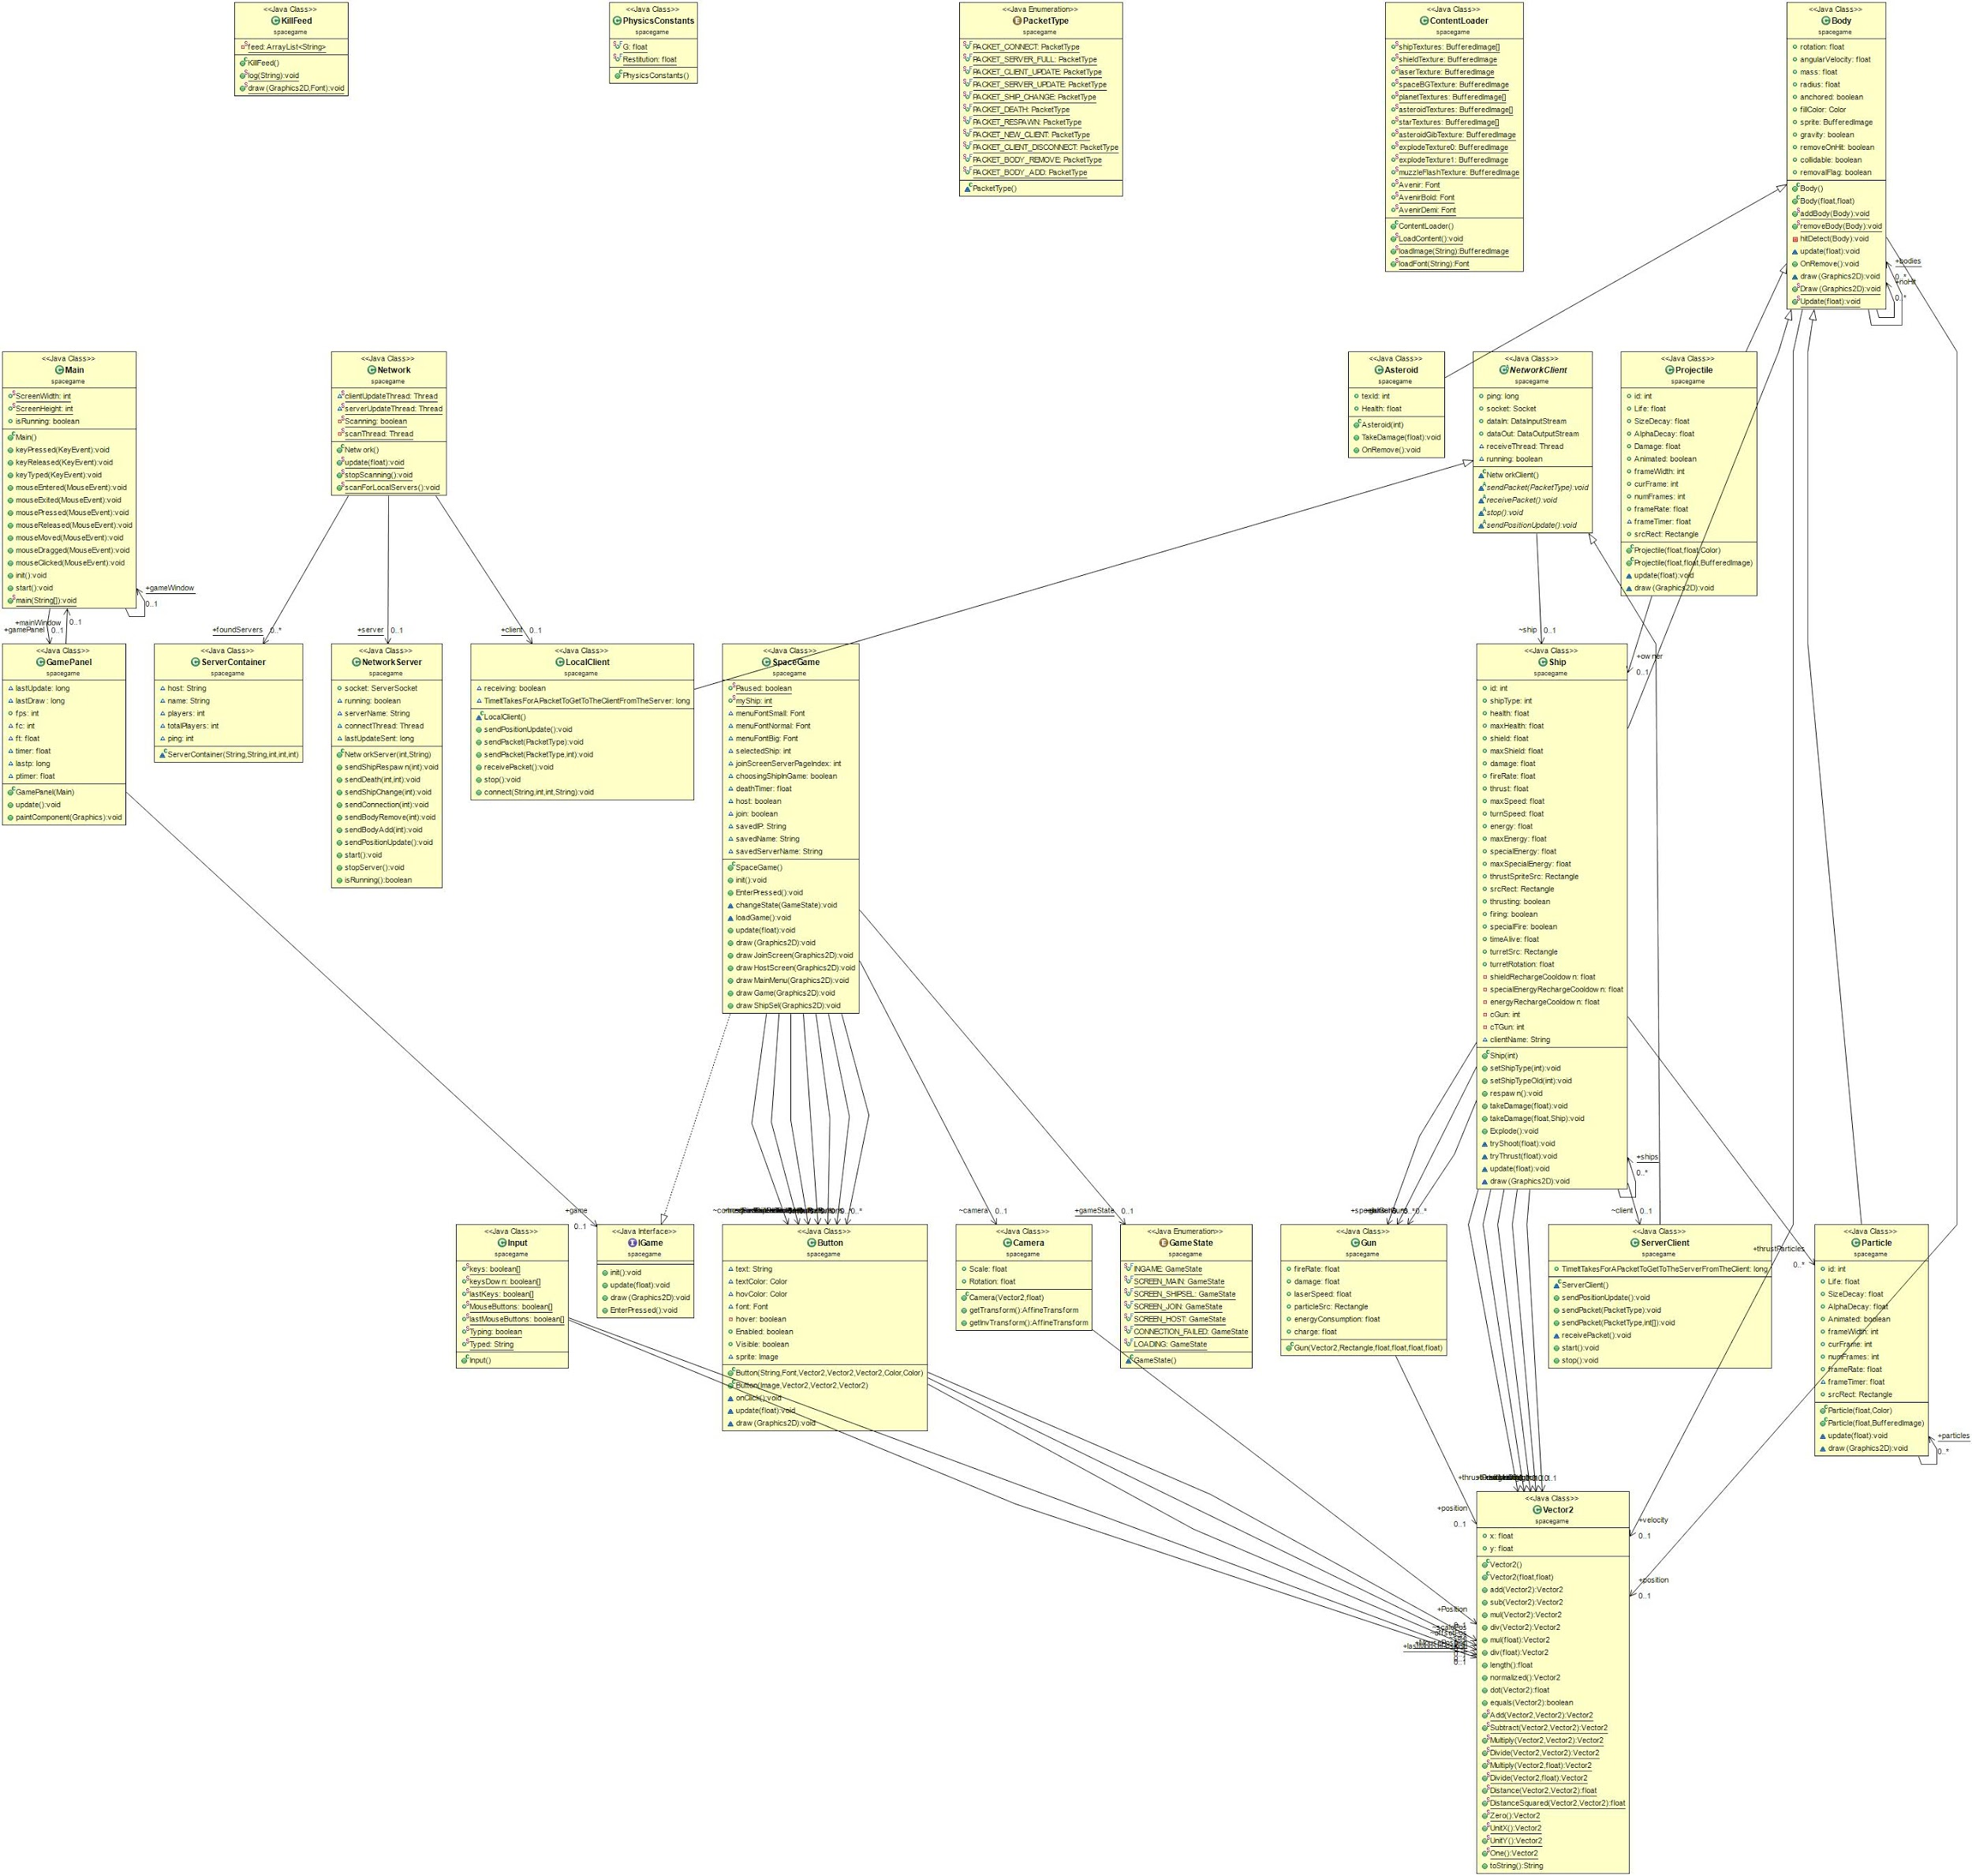
UML Diagram
Too big for one slide

Slide 6
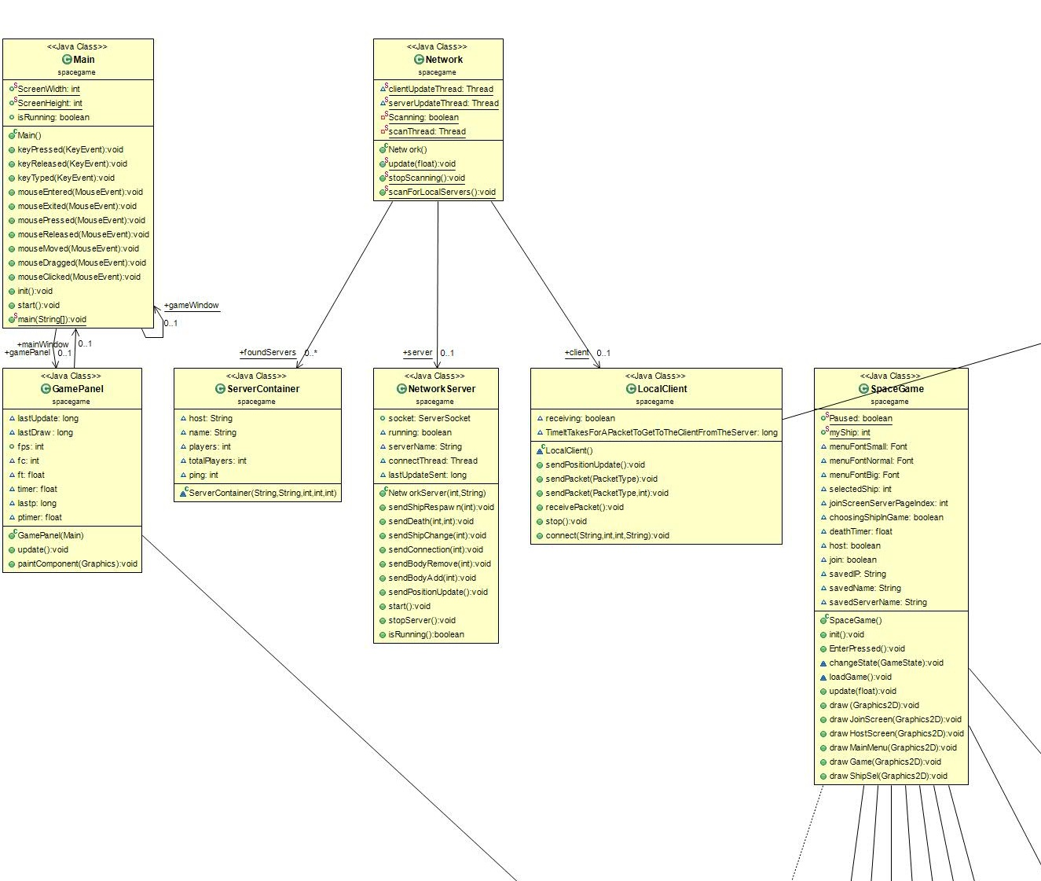
UML Diagram
The basics

Slide 7
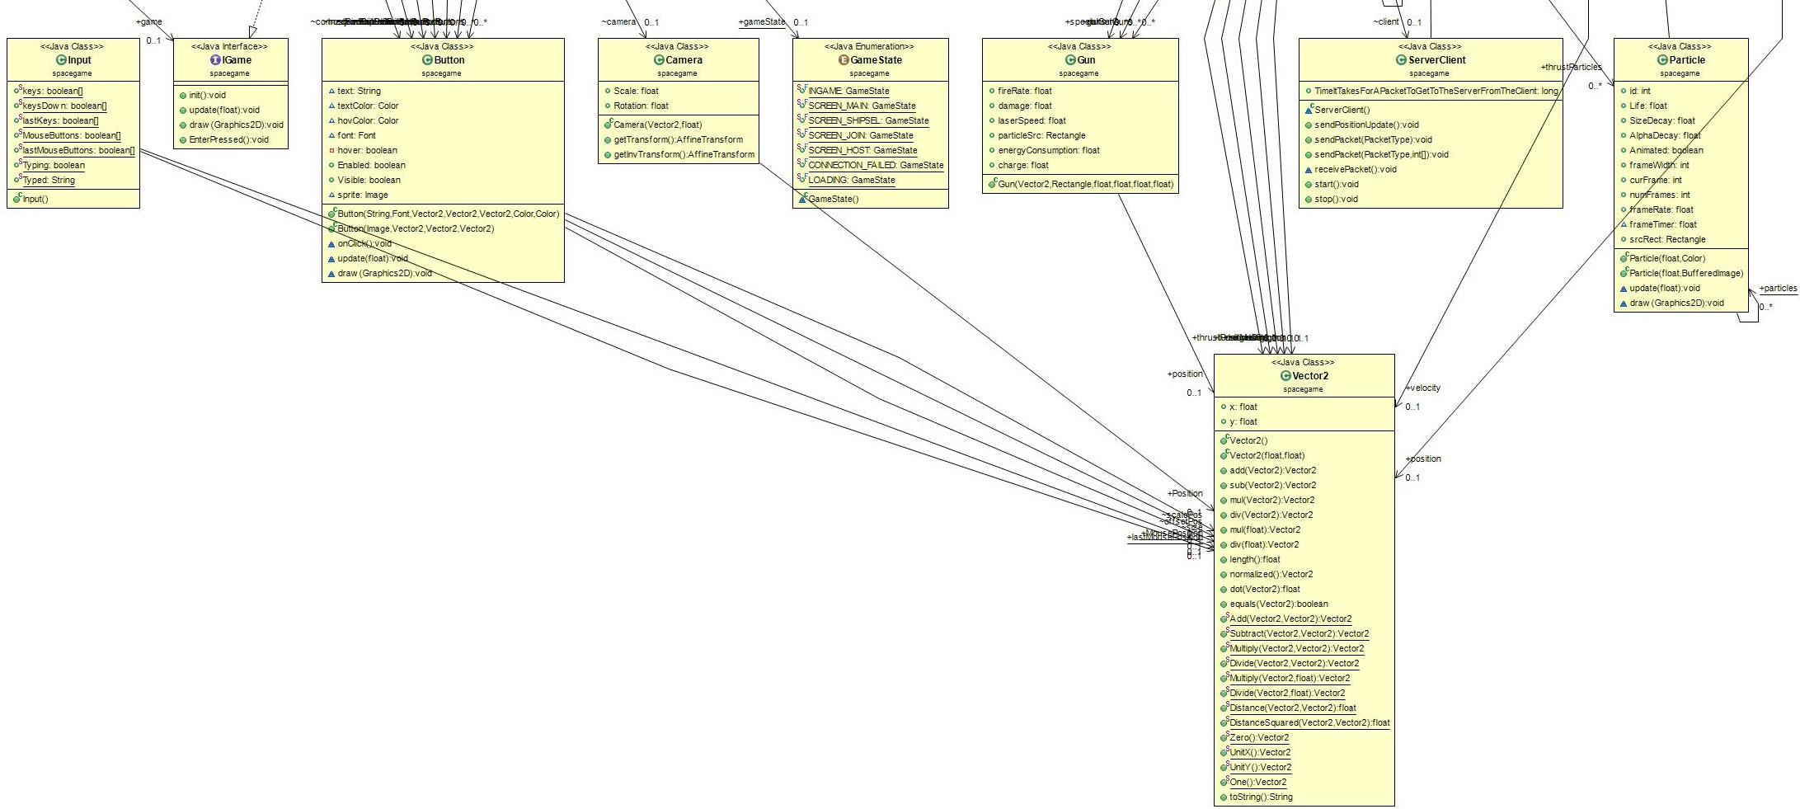
UML Diagram
UI and more basics
Also some network stuff

Slide 8
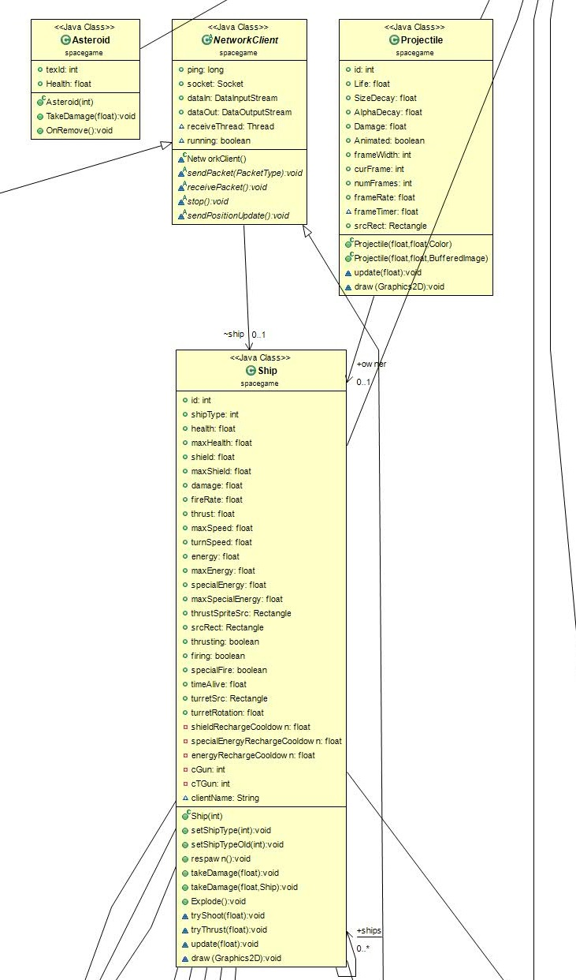
UML Diagram
Network client and projectiles

Slide 9
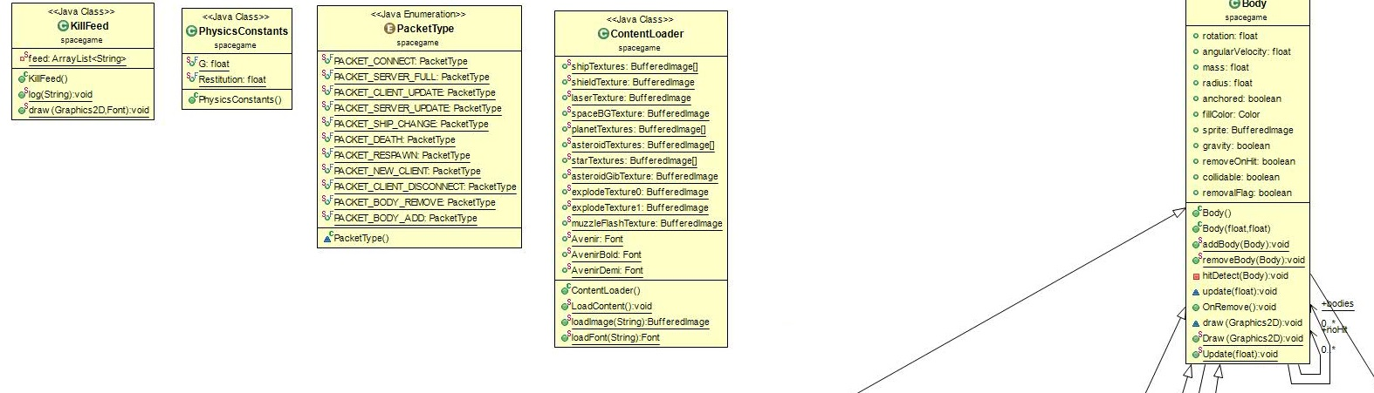
UML Diagram
Static things (constants, resources) and Bodies

Slide 10
Classes
Vector2
Body
Asteroid extends Body
Projectile extends Body
Ship extends Body
Gun
Button
Camera
ContentLoader
KillFeed
Network
NetworkServer
NetworkClient
ServerClient extends NetworkClient
LocalClient extends NetworkClient
ServerContainer
Particle extends Body
PhysicsConstants
SpaceGame implements IGame
GamePanel extends JPanel
Main extends JFrame implements KeyListener, MouseListener, MouseMotionListener
Input

Slide 11
Class Interaction
Program starts in Main -> creates a Main class (the main window)
Main takes input and stores it in Input
Main class creates GamePanel (for graphics within the main window)
Main class calls the GamePanel’s Draw() and Update() method
Tries to call Draw() 60 times per second, and Update() in between.
GamePanel creates IGame interface, relays Draw() and Update()
SpaceGame implements IGame, receiving Update and Draw calls
SpaceGame calls Update() on Body, Projectile, Ship, Particle, NetworkServer, LocalClient, and any active Buttons
SpaceGame calls Draw() on Body, Projectile, Ship, Particle, and any active Buttons; then draws UI overlays depending on the current GameState
GameStates include INGAME, LOADING, SCREEN_MAIN, etc..

Slide 12
Inheritance Hierarchy
Body
Base class for all physical bodies
Has variables like Position, Velocity, Radius, Mass
Projectile
Ship
Particle
Asteroid
NetworkClient
Base class for handling network interaction
Has methods like SendPacket, RecievePacket
ServerClient
LocalClient
Exist on the server, allows server to communicate with a single client
Exist on a client connected to a server, allows that client to communicate with a server

Slide 13
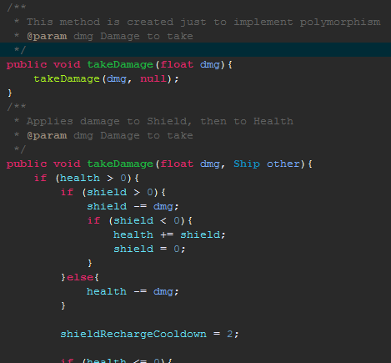
Polymorphism
takeDamage() makes a ship take damage, gets called when a ship hits another body.
The first takeDamage() method simply calls the other takeDamage() giving it null for the other parameter.

Slide 14
Interfaces
IGame is used to create an interface for GamePanel so that GamePanel can update and draw and class that implements IGame, creating an outline for any game to be made with this platform.

Slide 15
Special Features
Can scan the local network (to a degree) for any servers running, and lists them.
Uses TCP for maximum reliability with data sent across the network.
A variable in LocalClient is: TimeItTakesForAPacketToGetToTheClientFromTheServer Allowing for the client (and server!) to calculate ping
When a third player joins, sometimes the game crashes. If it doesn’t crash, the second player who connected to the server will have planets flying across their screen for no reason. I did not implement this. I do not know why this happens.

Slide 16
Known bugs
Local server browser won’t find servers with IP addresses that have different first 3 numbers.
When a new client joins, there’s a chance the entire game will crash for everyone but the host of the server.
It’s written in Java, so it will run out of memory or have a NullPointerException because of JVM garbage collection after a while.

Slide 17
“Second-party” code
Didn’t use any
I barely know what “second-party” means
If you count JVM as third-party code, then sure… still not second party tho

Slide 18
Conclusion
Pretty fun game
Java is slow

Slide 19
Questions
Why would anyone write a real game in Java
Minecraft was written in Java
It’s really slow

